Slide 1
Evidence to Impact
Introducing Logic Models

Slide 2
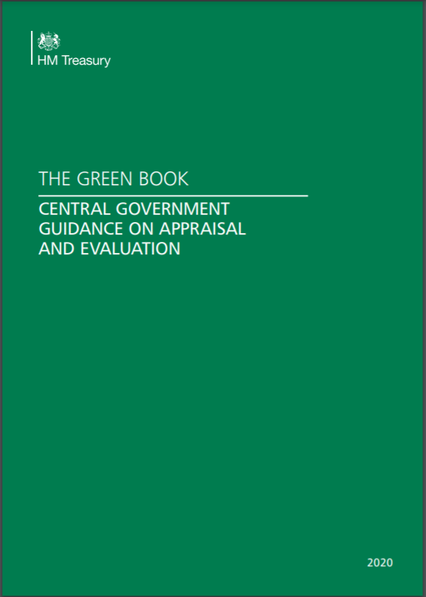
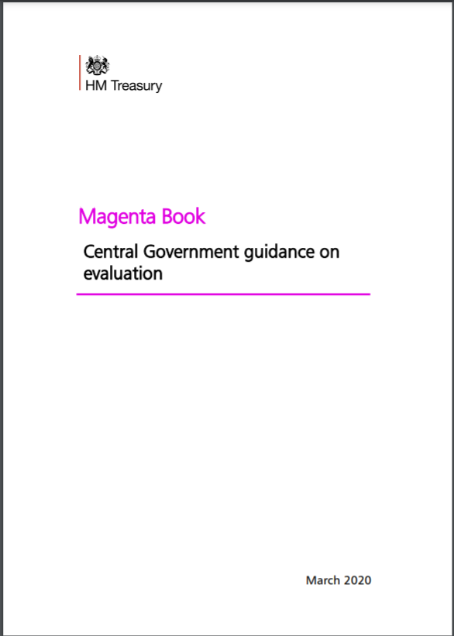
Book of many colours
Notes:
The Green Book: Appraisal and Evaluation in Central Government (HM Treasury, 2003, amended in 2016) sets out a broad policy cycle, known as ROAMEF that positions monitoring and evaluation as key stages within the development and implementation of effective policy.
The Magenta Book: Guidance for evaluation (HM Treasury, 2011) defines evaluation as “an objective process of understanding how a policy or other intervention was implemented, what effects it had, for whom, how and why.” They go onto argue that “Not evaluating, or evaluating poorly, will mean that policy makers will not be able to provide meaningful evidence in support of any claims they might wish to make about a policy’s effectiveness. Any such claims will be effectively unfounded.”
Focus on monitoring and evaluation, and use of logic models
Prof Henry Overmann et al . . . ‘What Works- Strong evaluation methods, hypothesis testing, continuous improvement evaluation
Green Book review following Budget 2020 to address - Concerns re 2018 guidance undermining Government’s 'levelling-up' intent (not all contexts the same . . . & its more than ec impact) and UK’s legal requirement to achieve Net Zero by 2050 (revisiting appraisal of environmental impacts)

Slide 3
Recent tweaks to thinking made by HMT
 | Key Changes
Defining Value for Money for a Balanced Appraisal | VfM encompasses all relevant societal costs & benefits, not just the narrowly economic ones Strengthened guidance on setting SMART objectives for which all long-listed options are to be assessed. Options that don’t deliver them cannot be considered VfM, regardless of BCR Reviewers are to challenge any BC which does not meet Green Book standards & be open to BCs with low BCRs if they deliver best VfM for achieving the strategic objectives
Identifying Objectives for the Delivery of Strategic Outcomes | Introduction of a project scorecard, including guidance, templates & training Revisit options strategic alignment at the short-listing stage in response to evolving Government wider strategic objectives
Transformational Impacts | Transformational change should be assessed & reported at the level of strategy, & projects & programmes should be appraised on delivery to strategy objectives In absence of a step-by-step method to produce precise valuations of transformational impacts, a robust & well evidenced logical process of change should be included.
Improving Analysis of Regional & Local Impacts | Analysis should consider differential place-based impacts, with new guidance including: - new employment multipliers to help estimate the local impacts - taking equalities impact into account (Public Sector Equality Duty) - considering the impact on different people/groups & the associated costs & benefits - new requirement for appraisers to consider the impact of decisions on families
Notes:
Stronger and clearer advice on what constitutes value for money. This will ensure that projects are being assessed first and foremost on how well they deliver policy objectives rather than focusing on a purely economic assessment that doesn’t consider who benefits
A stronger requirement to establish clear objectives from the outset that must be the drivers of the policy development, and to show a robust logic of change from inputs to outcomes.
New guidance on how to assess local impacts, to capture different impacts on different places and local employment effects. Proposals without an assessment of place-based impacts will be challenged and business cases tested rigorously.
Greater transparency with a new requirement to publish a summary business case after they receive final approval. This will begin in April 2021 for all infrastructure projects and programmes on the Government’s Major Projects Portfolio.
Announcement that HMT will lead an expert external review on the application of the Green Book discount rate to environmental impacts. This review will conclude next year

Slide 4
Growth of logic model approaches
Context/
Conditions
Rationale for intervention
Objectives
Options for intervention
Inputs
Impacts
Outcomes
Outputs
Activities/
Processes
Economic
Social
Environment
Notes:
A programme logic model (PLM) is a diagrammatic representation of an intervention’s objectives, inputs, activities, outputs, outcomes, and impacts. A theory of change (ToC) sets out the causal links and enabling/liming factors to reach those outcomes and impacts. This provides the basis for theory-based evaluations, establishing the hypotheses to test.
Our evaluators are clear – if you can’t write a logic model, than your programme/project isn’t ready to go
There is no ‘right way’ – you can start wherever, and can go back and forth. For example, you might question whether a particular activity (information sessions) can really deliver a particular outcome (increased skills) and decide to change either the outcome or the activity. This means that you are exploring the assumptions behind your activities and questioning the
theory about how you make a difference. That’s what this process is all about!

Slide 5
Key considerations
Understanding the context for intervention - what local economic issues/opportunities is programme seeking to respond to?
The rationale for intervention - what is the case for intervening to address the Context in the form of the programme
The objectives of the intervention - what are the objectives for the programme, and to what extent are they SMART?
The options for achieving the objectives - what routes are explored to identify the practical ways in which the programme’s objectives might be realised?
Inputs - what resources – cash and in kind - have been garnered to fund the practical activities to achieve the objectives?
Activities - what practical actions will take place on the ground?
Outputs - what quantitative outputs will the activities generate, e.g., businesses supported, qualifications etc?
Outcomes - what quantitative results will the output generate in the wider North-East e.g. gross/net jobs, gross/net GVA?
Impacts - the difference the intervention has will make in response to the founding context and rationale for intervention
Notes:
Context – what is the problem or issue and for whom? How do we know (i.e what evidence do we have?) Why is this a problem?
Rationale for intervention – what happens if we don’t anything? Who is helping to resolved this issue and how do we fit in? What do we know about the factors affecting this issue i.e. market failures
Contextual conditions – availability of ‘right staff’, ability to recruit the ‘right’ beneficiaries, specific local/regional structural features
Objective – what do you hope to achieve?
Activities – what action will you take to achieve the objectives?
Outputs – what are the measurable effects of your work?
Outcomes – what difference will this make in the short and long term?

Slide 6
Testing the Model
Allows you to question ‘your logic’
Assumptions
  Is it meaningful or worth doing?
  Is it plausible? Can these activities really deliver these outcomes?
  Is it doable?
  Is it testable?
External Factors
  What changing factors might help or hinder the project or programme? (think PESTLE)
  Can you do anything about these factors?
  What stakeholders, funders, etc. can support or threaten your work?
Notes:
The process itself is just an important as the outcome – allows you to question your assumptions and your own logic
Is it meaningful – we have identified a problem, but other people might be concerned with others. Ask yourself ‘who cares and why’?
Plausibility – are you setting yourself up to fail by promising too much? Have you considered the short and longer term impact? Can these outcomes be sustained?
Doable – do you have the resources to deliver your activity? Do you have partner commitment?
Testable – can we tell if things are progressing?

Slide 7
Example: Freeport Logic Model
Notes:
The use of logic models was piloted across government last year and is now required for key programmes
The Freeport application process was an early example and the NE and other bidders had to each complete a LM based on the attached.
Required rigour in our thinking and analysis of activities and benefits
Also accompanied by some additional transparency in Government reporting of decision making – they were able to score across a number of mediated factors
Doesn’t remove the possibility of political prioritisation…….

